Slide 1

Modelling relative risk of eastern spruce budworm damage across Ontario using an odds-ratio approach
Clara Risk
Stephen Mayor
Patrick M. A. James

Slide 2


Eastern Spruce Budworm
Eastern spruce budworm is a forest insect pest that attacks spruce and fir trees in Ontario
Its larvae feed on buds, needles, and shoots, causing defoliation, reduced growth, and even tree death
Severe defoliation by the eastern spruce budworm can lead to significant economic losses for the forestry industry
Control measures include insecticides and silvicultural practices

Slide 3

Why Odds Ratios?
An odds ratio is a statistical measure used to compare the likelihood of an event occurring between two groups
Commonly used in medical research to determine the association between a specific risk factor and the occurrence of a disease
It provides valuable information on the strength and direction of an association, and it can help in making informed decisions regarding treatment or prevention strategies

Slide 4
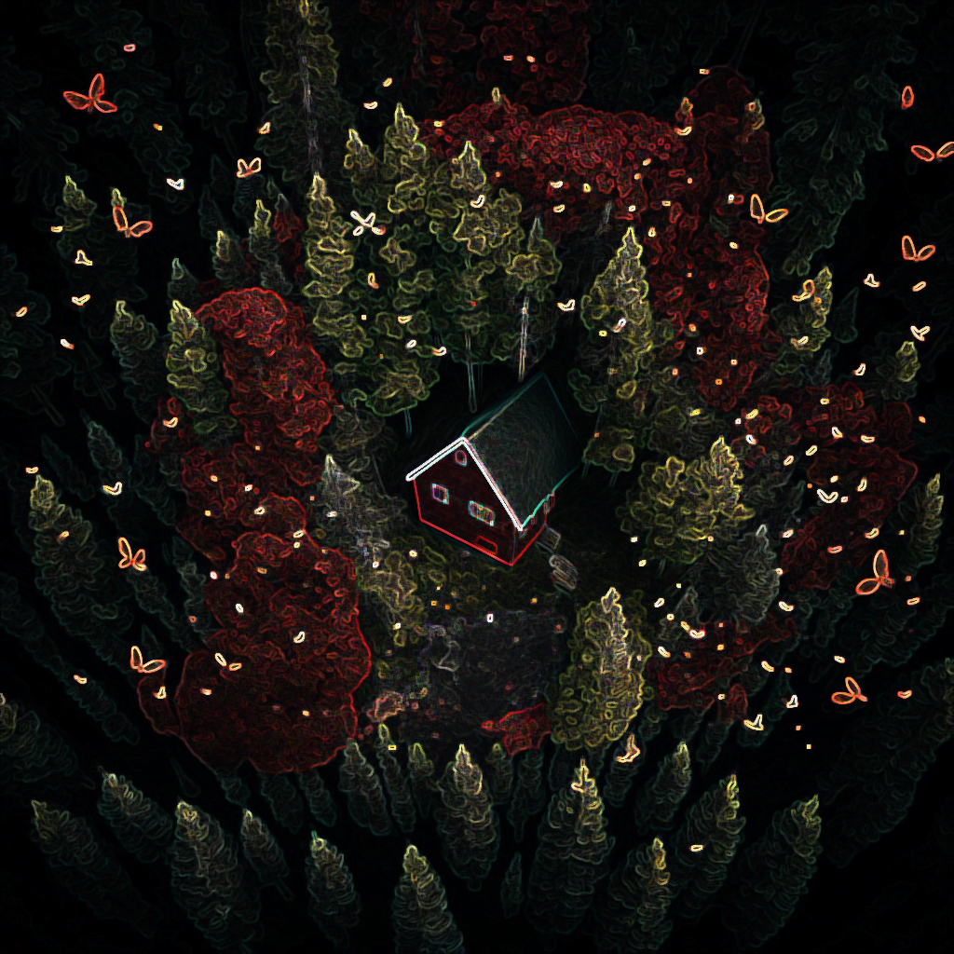
Why this research?
Quantifying and mapping risk of forest stands to spruce budworm helps prioritize management and conservation efforts and identify vulnerable areas for preventive measures
Mapping risk reduces economic losses, protects ecosystem services, and enables effective resource allocation
Odds ratios provide a practical tool to directly quantify forest stand risk

Slide 5
Covariates
Bouchard & Auger (2014):
Higher amounts of balsam fir in a forest stand are an important predictor of higher defoliation during a spruce budworm outbreak
Greater distance from the original defoliation area, greater amount of hardwoods, and greater elevation act as deterrents to the spread of spruce budworm and explain the expansion of the defoliation area
Factors influencing the impact of a spruce budworm outbreak are dependent on the stage of the outbreak
But this study was completed in Québec, which has a very different elevational and climatic profile than Ontario
Our response variable is tree damage

Slide 6
Data Sources
Species Abundance & stand age: Beaudoin et al. (2014) estimates produced from satellite imagery, environmental variables, and National Forest Inventory plots
Elevation: NASA SRTM Digital Elevation 30m
January minimum temperature: Daymet V4: Daily Surface Weather and Climatological Summaries from the NASA ORNL DAAC at Oak Ridge National Laboratory
Soil Texture: OpenLandMap Soil Texture Class (USDA System) from EnvirometriX Ltd
SBW damage: custom dataset produced by our lab using Landsat and Ontario’s aerial survey maps to estimate damaged area (previously presented at conferences such as NAFEW, SERG-International, and Ecological Society of America)

Slide 7
Calculating Odds Ratios
To calculate an odds ratio, you need to compare two groups and see how likely they are to experience a particular outcome
You do this by creating a table, calculating the odds of the outcome for each group, and then dividing the odds of one group by the odds of the other group
It's important to control for any other variables that might influence the outcome – this can be done using linear regression, which allows you to adjust for covariates
An odds ratio greater than 1 means the outcome is more likely in the first group, while an odds ratio less than 1 means the outcome is more likely in the second group
An odds ratio of 1 means there's no difference between the groups

Slide 8
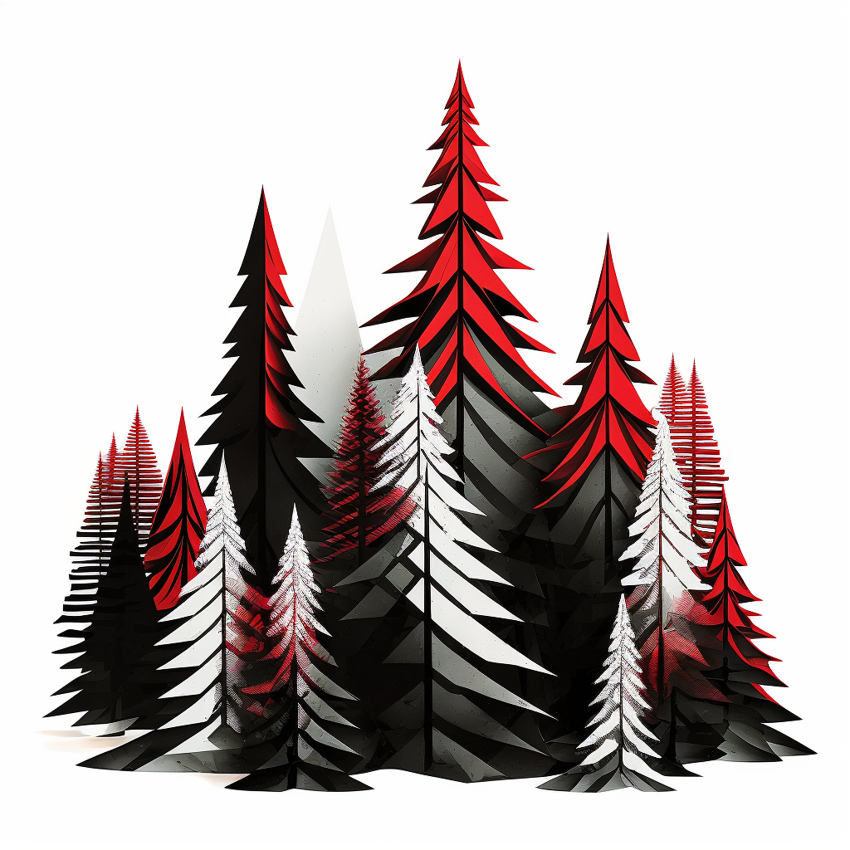
Graphing Odds Ratios
We selected the comparison group by choosing the 45-55th percentile of covariate values to represent an "average" stand in the study area
We iterated through each covariate range at a specific step size and extracted all pixels falling within the buffer size (e.g., 5% for balsam fir)
We calculated the odds ratio for each range of values compared to the "average" stand, and plotted the results on a graph with a 95th confidence interval
The average stand in the study area:
Elevation: 261-299m
Balsam Fir Abundance: 0-2%
Black Spruce Abundance: 34-45%
Stand Age: 70-79 years
Minimum January Temperature: -25 - -26°C
Soil Texture: Loam (Class 7)
Percent of Area Damaged by SBW (2021):

Slide 9
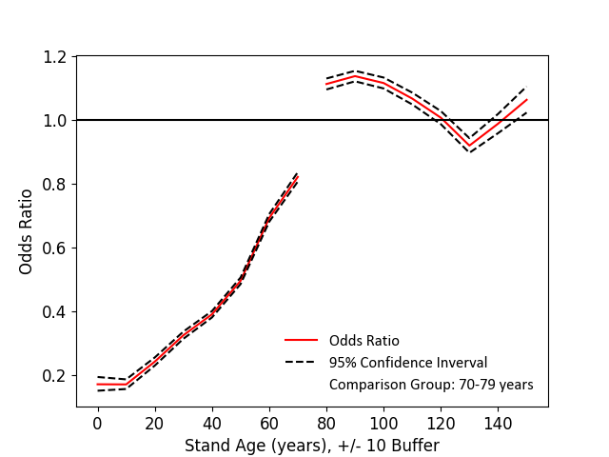
Forest Stand Age
Younger trees are less at risk of SBW damage compared to mature ones

Slide 10
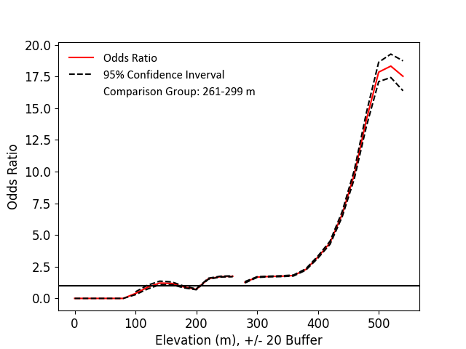
Elevation
Higher elevations in this study area are catastrophically more at risk of damage compared to an “average” stand

Slide 11
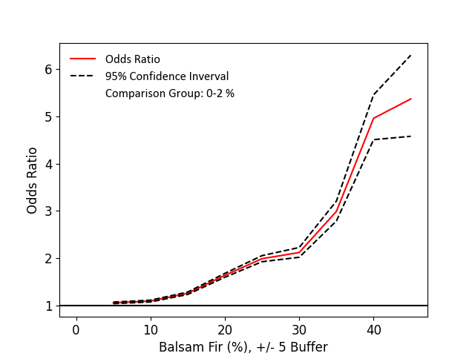
Balsam Fir
Higher abundance of balsam fir in a pixel is associated with a much higher risk of damage compared to an average stand

Slide 12
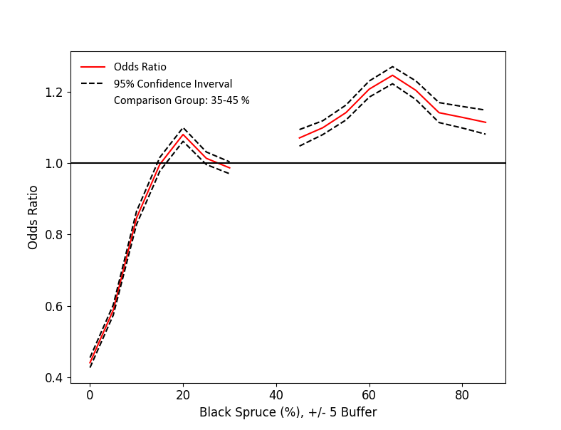
White & Black Spruce
Lower abundance of black spruce in a pixel is associated with a much lower risk of damage compared to an average stand

Slide 13
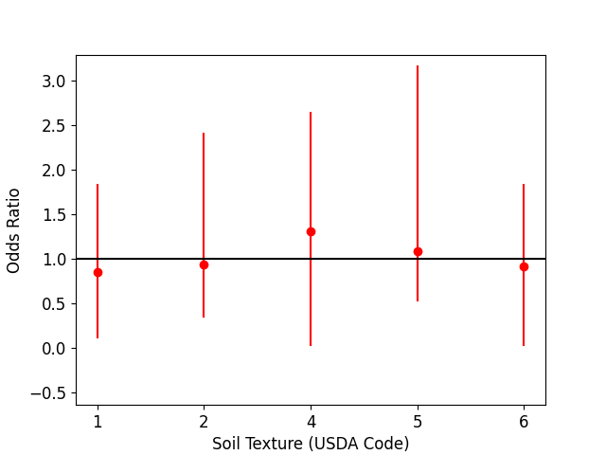
Soil Texture
No soil textures appear to be at increased or decreased risk compared to the reference soil texture (loam).

Slide 14
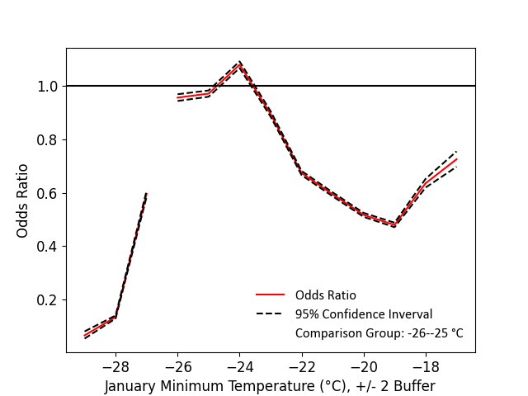
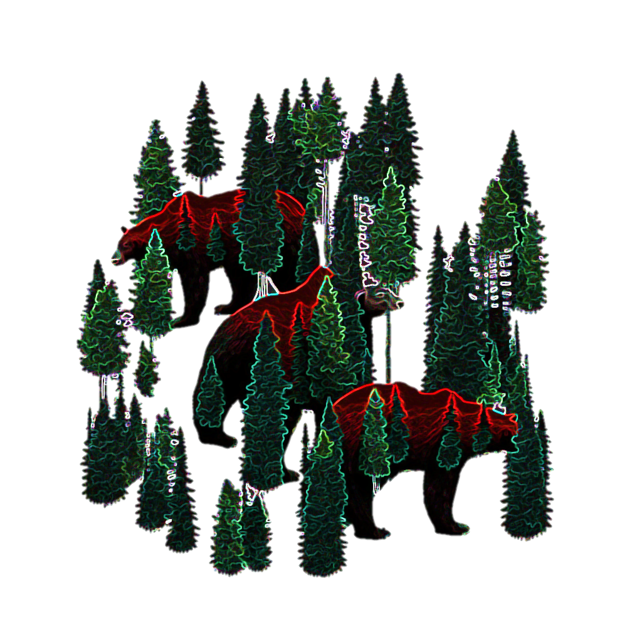
Minimum January Temperature
NOT TOO HOT, NOT TOO COLD, JUST RIGHT
Colder and warmer temperatures are less at risk of tree damage compared to the reference temperature of -25 - -26°C.

Slide 15
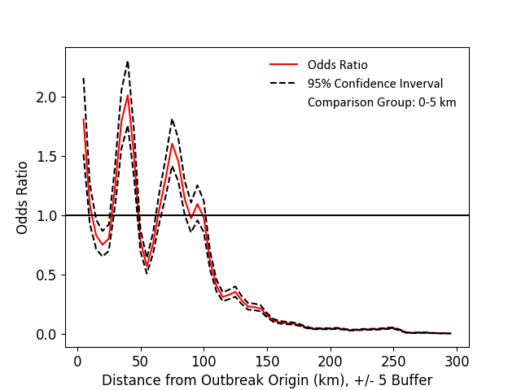
What about spatial autocorrelation?
At 2021, we are in the middle of an outbreak, so it has damaged trees out from the original centroid. We see this in the odds ratio graph. Stands at 100km+ from the centre are less at risk of damage.

Slide 16
Summary So Far
Elevation is by far the most important variable – relative risk of damage rises sharply above 400m
Balsam fir follows in importance with relative risk rising sharply past 30% abundance in a pixel
Other covariates less important – generally, more risk is associated with minimum January temperature of 26°C, higher abundances of black spruce, and older stand age

Slide 17
Relative risk of forest stands
Map the odds ratios across Ontario
Estimate the odds ratios across Ontario using a fitted polynomial for each covariate
Multiply the odds ratios together to get a combined risk metric
Generate maps at different resolutions
INSERT GRAPHIC OF FITTED POLYNOMIALS

Slide 18
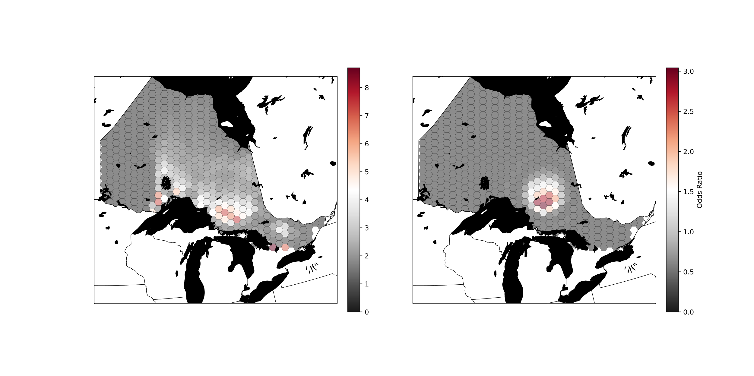
Relative Risk Map – 5km Resolution

Slide 19
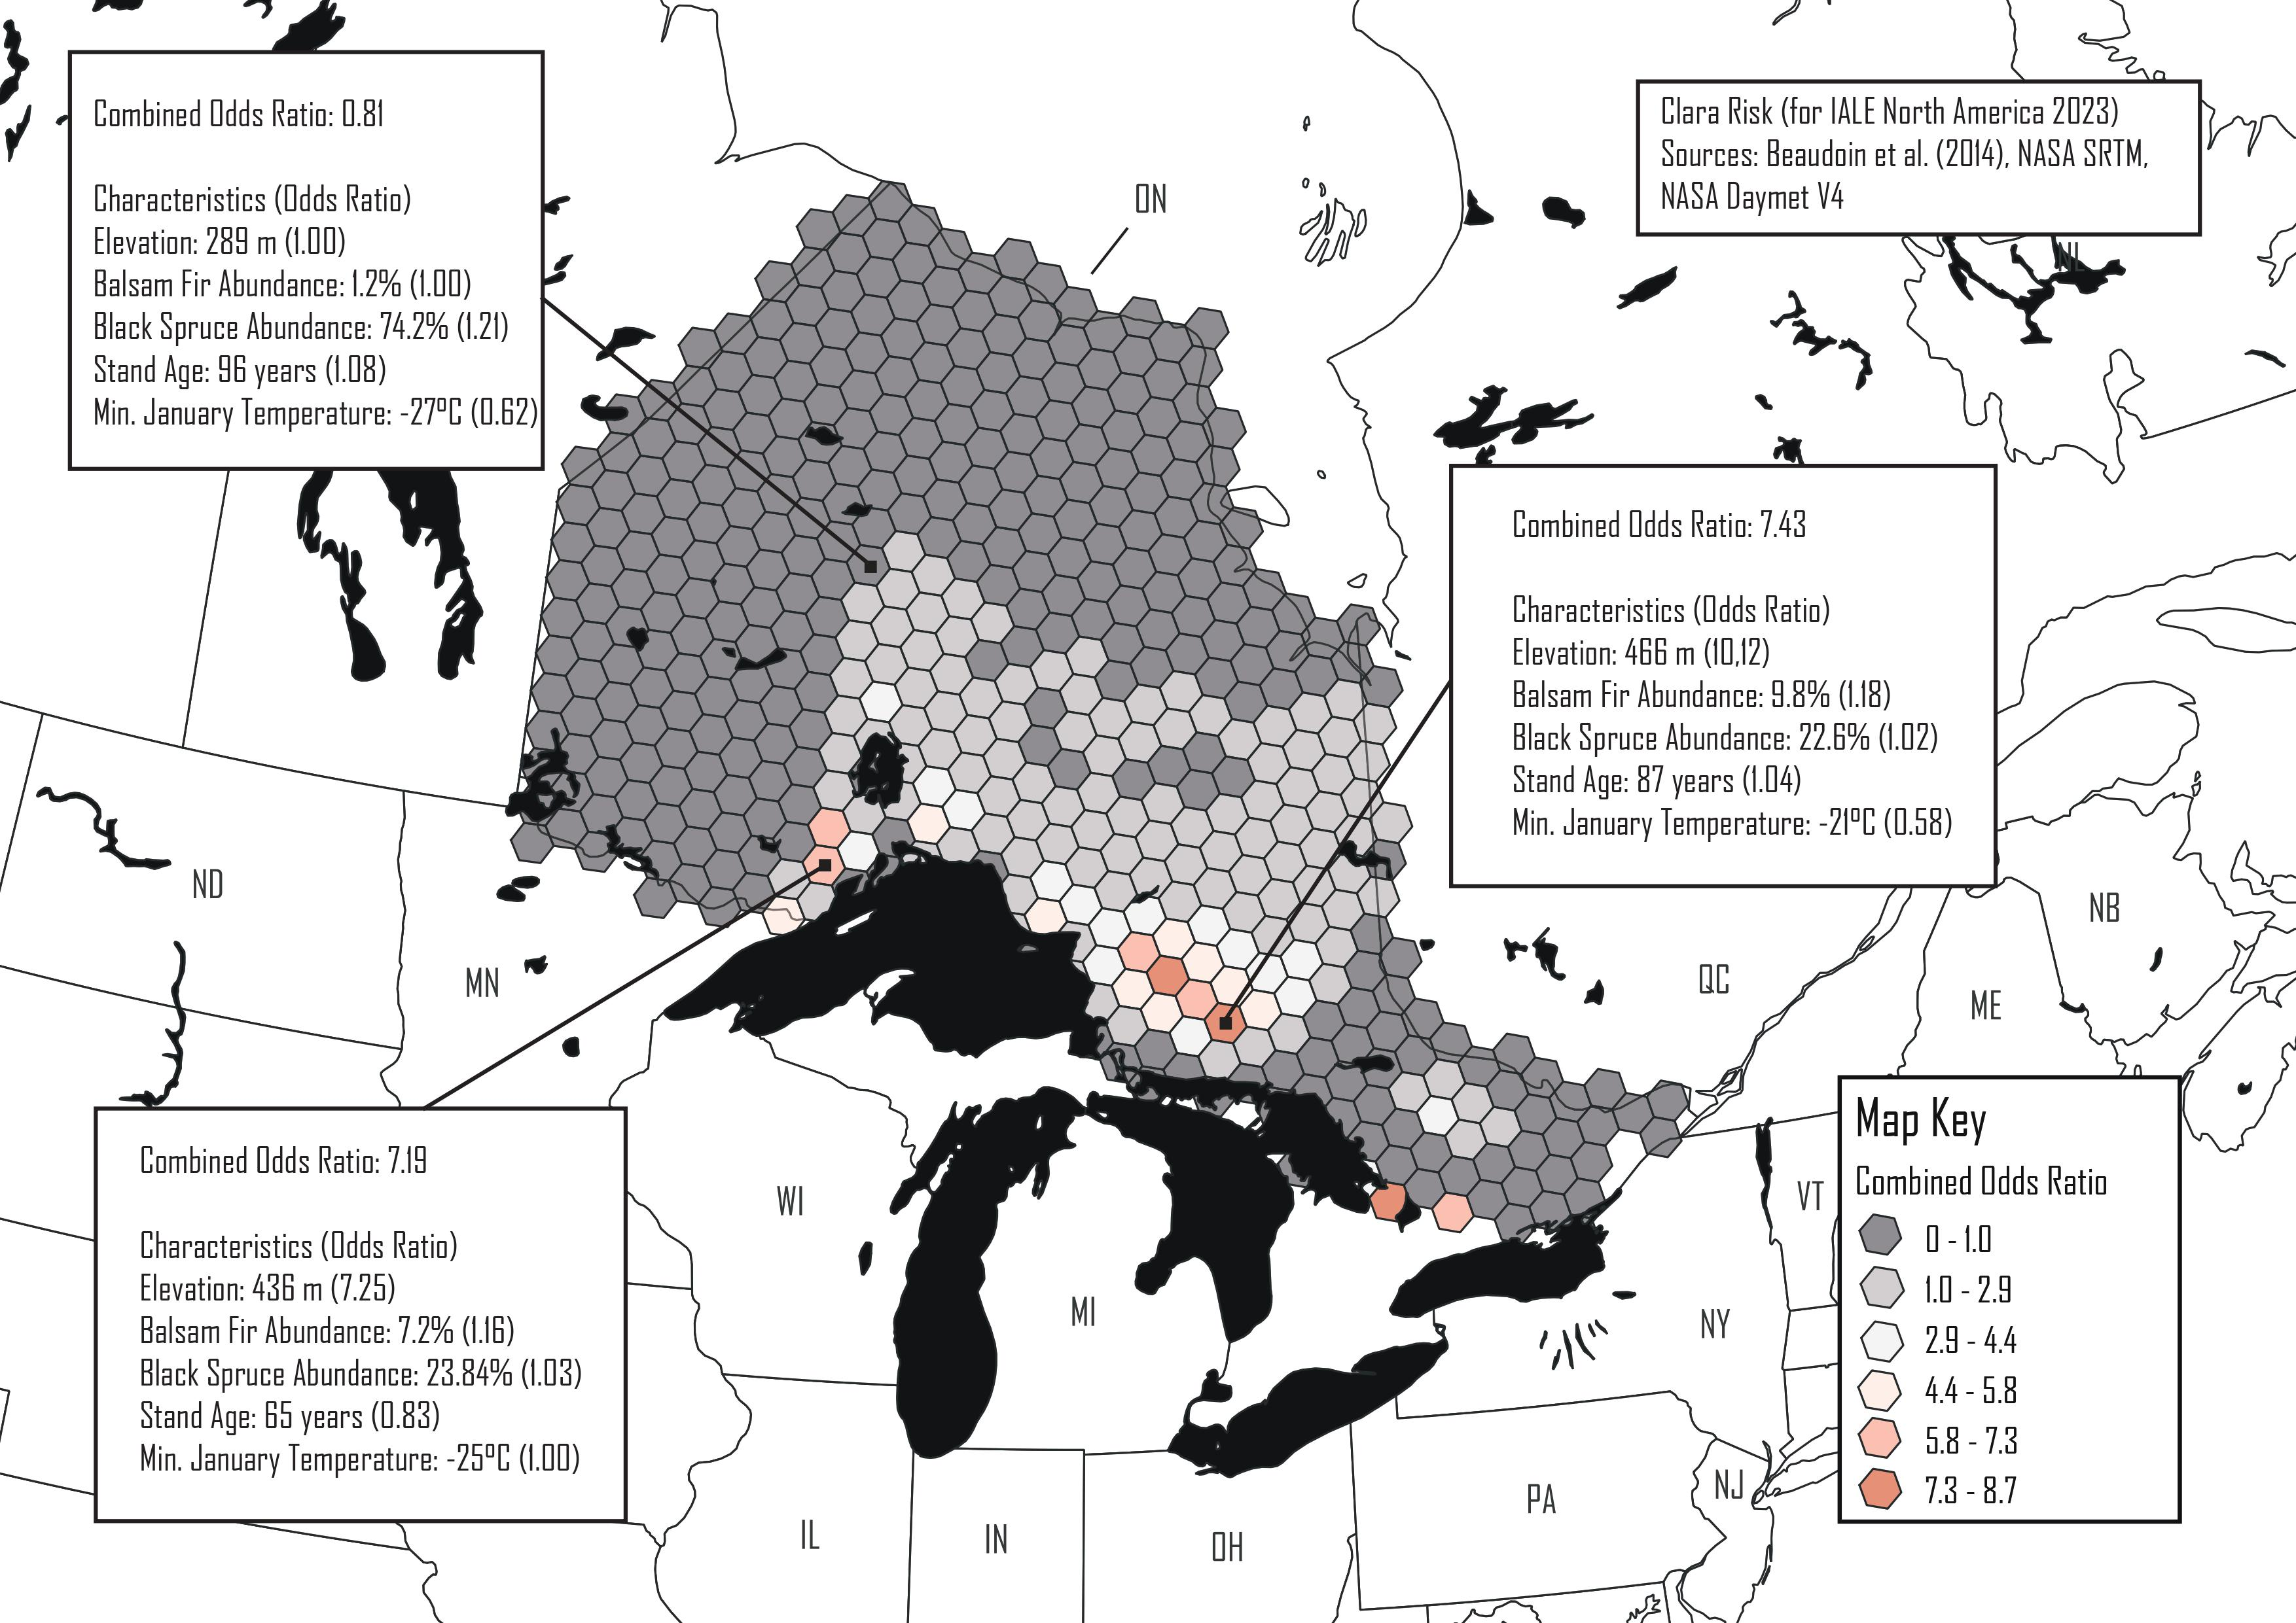

Slide 20
Relative Risk Map – 1km Resolution

Slide 21
What have we learned?
Generally, elevation is an extreme factor in SBW damage of trees
Northwestern Ontario could be highly at risk of SBW damage in the future based on the odds ratio analysis
However, proximity to the centroid of the outbreak has an intense effect on relative risk of a stand, meaning that it’s unlikely this area is in immediate danger
The resolution at which relative risk is mapped is an important consideration

Slide 22
References

